Slide 1


SCIKIT-LEARN

Slide 2

Sklearn
Sklearn allow us:
perform preprocessing steps in our datasets
perform data splitting
generate multiple different models
evaluate model’s performance
https://scikit-learn.org/stable/
Why this library?

Slide 3
Sklearn
Transformers are stored in preprocessing module of sklearn library
from sklearn.preprocessing import transformer
Available transformers:
StandardScaler()
MinMaxScaler()
PowerTransformer()
QuantileTransformer()
RobustScaler()
Normalizer()
OrdinalEncoder()
OneHotEncoder()
Scikit-learn transformers

Slide 4

Sklearn
This transformer does the following:
Compute:
mean of every column
standard deviation of every column
For every value of a column, it substracts the column’s mean and divide by the standard deviation of the column.
Scikit-learn StandardScaler()

Slide 5
Transformers need to gather some information from the dataset in order to apply a transformation.
They operate in two steps using the methods fit() and transform():
transformer.fit(df)
transformer.transform(df)
Both steps can be combined in a single method fit_transform():
transformer.fit_transform(df)
They always return a np.array.
If a df is desired, use pd.DataFrame(numpy.array, columns=...)
Sklearn
Scikit-learn transformers

Slide 6
Sklearn
K-Means is a clustering method which can be found in: sklearn.cluster
from sklearn.cluster import KMeans
K-Means works better when the features had been previously scaled with the StandardScaler() as is sensitive to the scale.
Link1 Link2
As an object, KMeans() works similarly to a transformer, it has two methods fit() and predict():
KMeans().fit(df)
KMeans().predict(new_sc_samples)
Sklearn's KMeans documentation
Scikit-learn KMeans

Slide 7
Sklearn
There are three main methods to determine the best K value:
Business restrictions/knowledge
Elbow method
Silhouette method
Scikit-learn KMeans best K?

Slide 8
Sklearn
Your boss demanded a specific number of groups? (money costs talks)
Does it makes sense to have so many or few groups?
What is a reasonable amount of groups?
KMeans best K: business restrictions

Slide 9
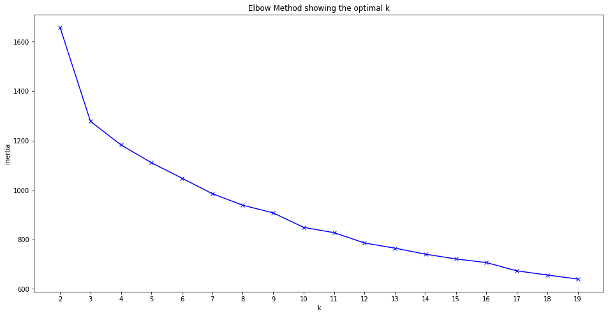
Sklearn
This method computes the average distance between every member of a cluster and the centroid of the cluster to which belongs as a function of the number of clusters.
The best number of clusters is the one for which previous amount doesn’t drop significantly.
KMeans best K: elbow method

Slide 10

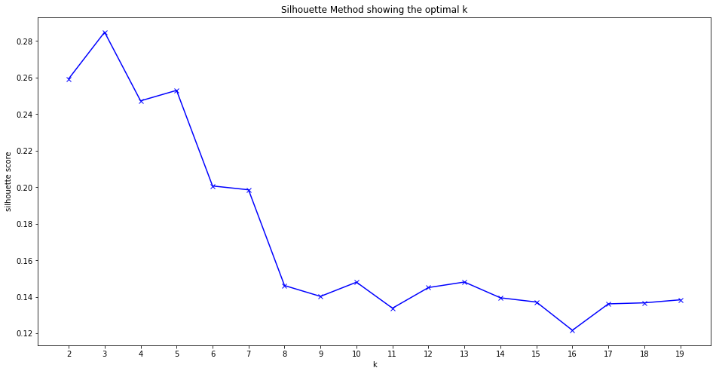
Sklearn
This method computes the “goodness” of the clustering based on:
Mean intracluster distance = a
Mean nearest cluster distance = b
The Silhouette score is given by:
The best number of cluster is selected as the one with the best score.
KMeans best K: silhouette method

Slide 11

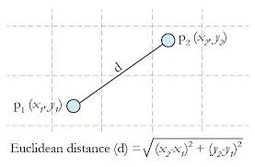
Euclidean Distance

Slide 12
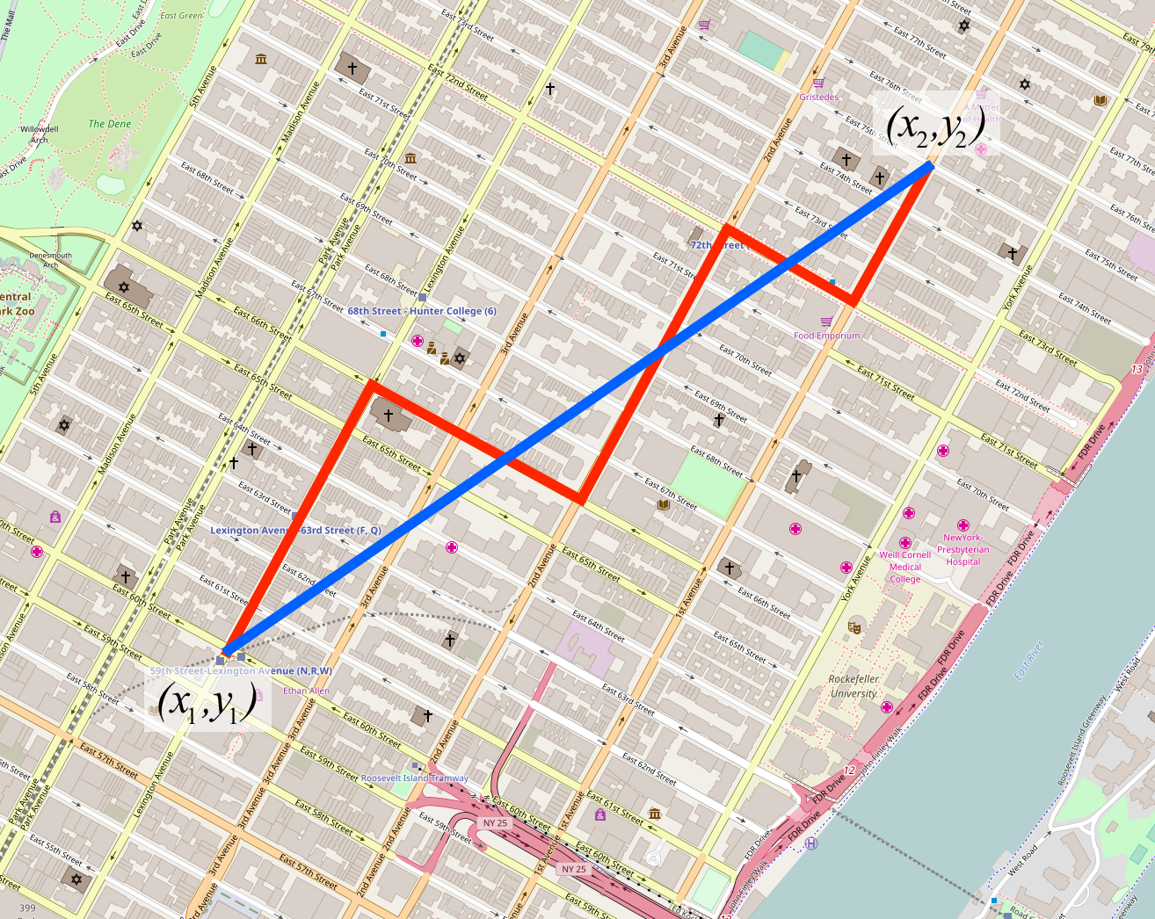
Manhattan Distance

Slide 13
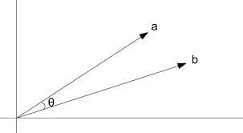
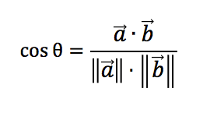
Cosine Distance

Slide 14
Pickle
Now we have a transformer and a model already trained. How we can store them?
The answer is the pickle library:
import pickle
To save the pickle:
def save(amount, filename = “filename.pickle”):
with open(filename, "wb") as f:
pickle.dump(amount, f)
To restore the pickle:
def load(filename = “filename.pickle”):
try:
with open(filename, "rb") as f:
return pickle.load(f)
except FileNotFoundError:
print(“File not found!”)
Pickle: saving and loading objects

